Slide 1
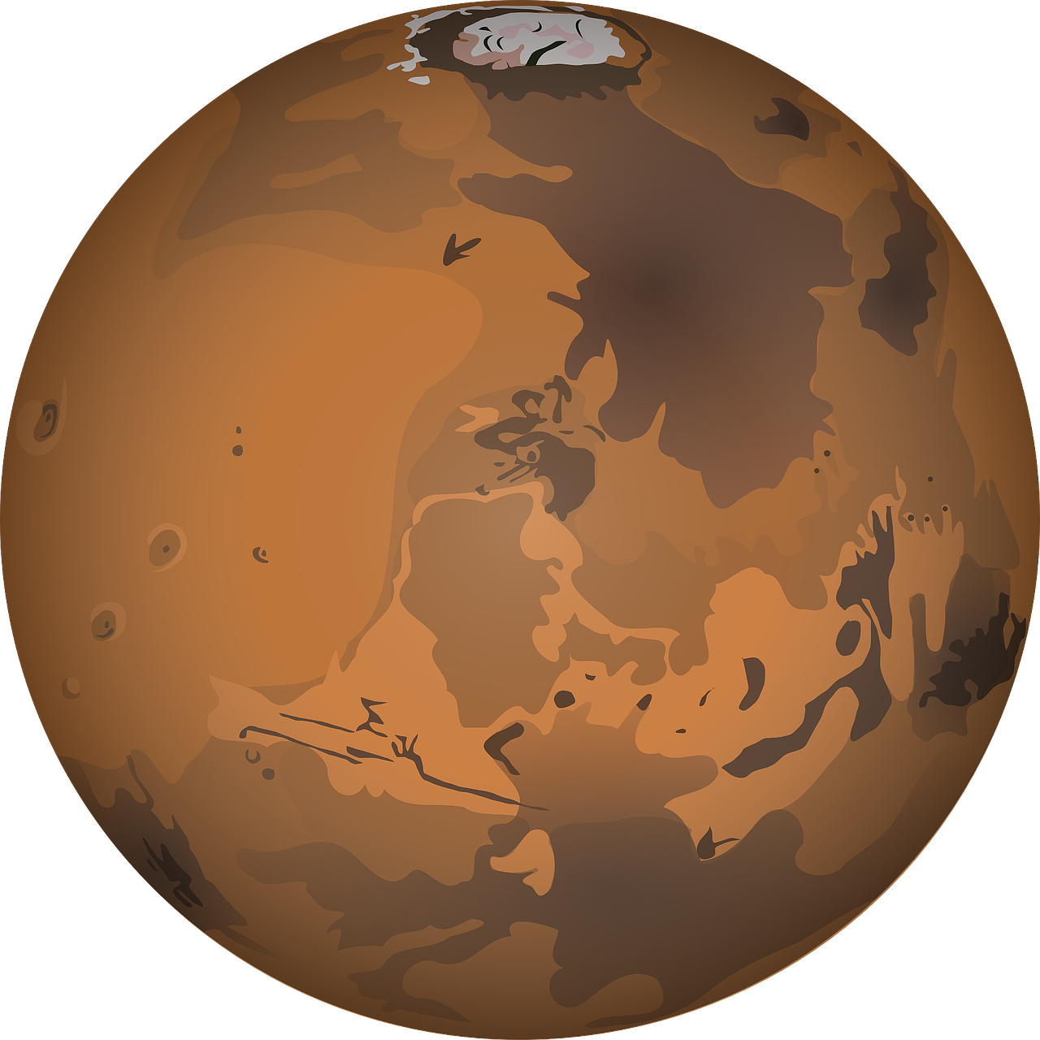





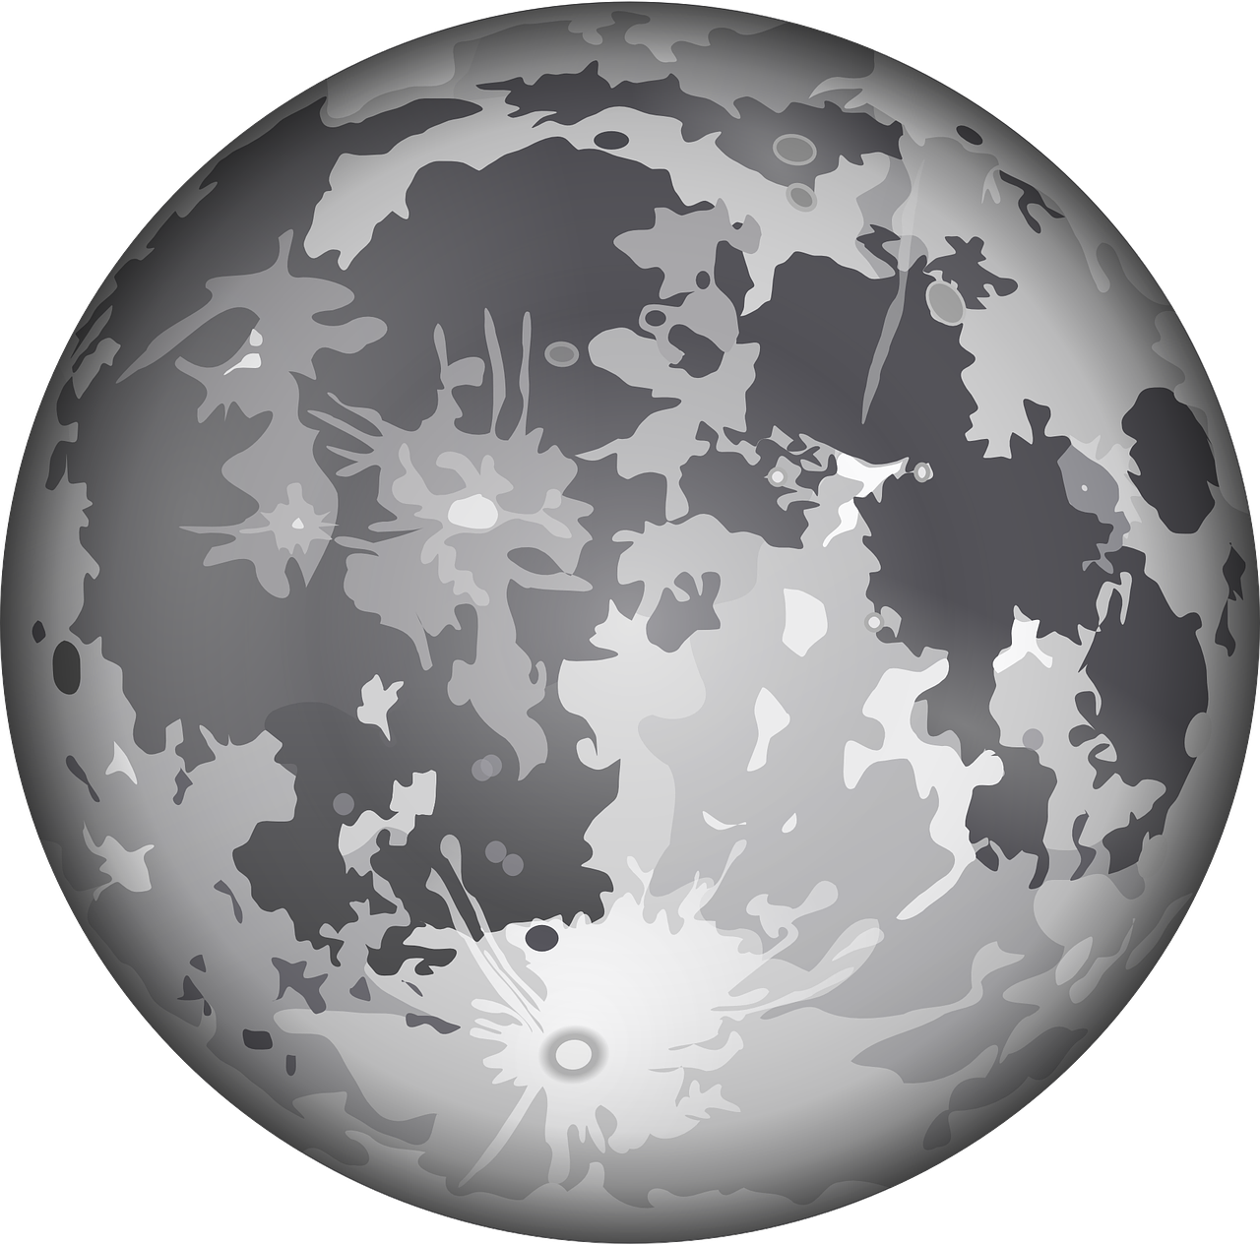

Instruction 1
In this game, you travel to some planets to collect money. Your payment will depend on how much you collected in your trips.
This is the map of your journeys
Brown Dust
Helium-Red
Earth
Grey Dust
Helium-Blue

Slide 2
Instruction
In this game, you are going to have 365 journeys (in one year = 365 days) into the space among some plants.
Here are the plants you might visit:
Planet Earth
Planet Brown-dust , and planet Gray-dust
Extragalactic planet Helium-blue , and extragalactic planet Helium-red

Slide 3

Instruction
Every day, depending on their mood, aliens put their money in Helium-Red or Helium-Blue planet.
However, once in a while, (usually every 5 to 8 days) their mood changes and they shift their investment to the other planet.
To collect more money, one should try to figure our which helium planet is fashionable now.
mood change
0.08 £
0.02 £
mood change
0.02 £
0.08 £

Slide 4
Instruction
Every day, some aliens, depending on their mood, put their money in one of the two extragalactic planets. For example, when they are in a certain mood, they put their money in the Helium-blue planet.
0.08 £
0.02 £

Slide 5
Instruction
Every day, some aliens, depending on their mood, put their money in one of the two extragalactic planets. For example, when they are in a certain mood, they put their money in the Helium-blue planet.
However, once in a while, in an unpredictable way (usually every 5 to 8 days) their mood changes and they decide to change their mind about where to put their money.
Every day, you should try to travel to the extragalactic planet that has the highest amount of money. The total money you will be paid at the end of the experiment will depend on how much money you collect from the extragalactic planets.
mood change
0.08 £
0.02 £
mood change
0.02 £
0.08 £

Slide 6
Instruction
On most days, you start from Earth. You first choose your spaceships. Black spaceship always takes you to Brown-dust. Redspaceship always takes you to the planet Gray-dust.
You make your choice by pressing the LEFT and RIGHT SHIFT buttons on the keyboard.
You have less than one second to choose. If you don’t respond fast enough, you will lose miss the opportunity.

Slide 7
Instruction
So let’s see how does your daily journeys between the planets will look like.
Most of the days, you wake up on the planet Earth and start your journey from there. In such days, you should quickly choose between two spaceships. The black spaceship always takes you to the planet Gray-dust, and the red spaceship always takes you to the planet Brown-dust.
You can choose your spaceship by pressing the left or the right shift-keys on the keyboard. But note that the location of the spaceship might change everyday. So for choosing a specific spaceship, you should press the left shift-key on some days, but the right shift-key on some other days.
You have less than one second for making your choice. If you don’t respond fast enough, you will lose the money you could have obtained on that day, and the next day starts.

Slide 8
Instruction
After you arrived in either the Gray-dust planet or the Brown-dust plant Press the SPACEBAR quickly and a galactic portal will open for you to go to next planet.

Slide 9
Instruction
From Gray-dust, the portal takes you Helium-red.
From Brown-Dust the portal takes you to Helium-blue.

Slide 10
Instruction
However, once in a while, in an unpredictable way (usually every 5 to 8 days) a galactic storm happens and swaps the destination of the two portals.
galactic storm
galactic storm

Slide 11
Instruction
Depending on where you started, the portals will take you to one of the two extragalactic planets. For example, you will arrive in the Helium-blue planet if you started from the Gray-dust planet, and will arrive in the Helium-red planet if you started from the Brown-dust planet.

Slide 12
Instruction
Depending on where you started, the portals will take you to one of the two extragalactic planets. For example, you will arrive in the Helium-blue planet if you started from the Gray-dust planet, and will arrive in the Helium-red planet if you started from the Brown-dust planet.
However, once in a while, in an unpredictable way (usually every 5 to 8 days) a galactic storm happens and it totally swaps the destination of the two portals.
galactic storm
galactic storm

Slide 13
Instruction
Finally, when you are Helium-blue or Helium-red you should press the SPACEBAR quickly to collect your money.
or
or
0.08 £
0.02 £
0.08 £
0.02 £

Slide 14
Instruction
So to summarize, in most of the days, you start from the planet Earth , and choose one of the two spaceships
, by quickly pressing one of the shift keys, in order to go to planet Gray-dust or Brown-dust . From there, a galactic portal opens and by pressing the space-key, it will take you to one of the two galactic plants, depending on your starting point. At the galactic destination, you will collect the money that the aliens have left on that destination, by pressing the space-key again.
The galactic destination of the portals change by unpredictable galactic storms, and the money location changes by unpredictable mood change of the aliens.
Galactic storms and alien’s mood changes happen totally independent from one another. That is, one does not have any effect on the other one happening.

Slide 15
Instruction
In some of the days, however, you don’t start from the planet Earth. Instead, when you wake up, you just find yourself in one of the two planets planet Brown-dust or Gray-dust . You can continue your journey from there by pressing the space-key to enter the galactic portal , and then collect the money at your galactic destination, by pressing the space-key again.
In yet some other days, when you wake up, you just find yourself in one of the two galactic planets Helium-red or Helium-blue . In those days, you just need to press the space-key in order to see and collect the money that the aliens have left you there.

